Slide 1


THEFT DETECTION by using face recognition
Presented by:
K.Deepthi (23RH1A66E7)
K.Udaya Keerthi(23RH1A66E4)
M.Neeraja(23RH1A66J3)
GUIDE: Mrs Vijaya Durga

Slide 2
CONTENTS:
Introduction
Existing system
Disadvantages of existing system
System Requirements
Proposed system with block diagram
Advantages of proposed system
Results with screen shots
Conclusion and Future scopes
References

Slide 3
INTRODUCTION:
Security is a major concern in homes, offices, and institutions.
Traditional CCTV systems only record video and require manual monitoring.
Face recognition provides a biometric and reliable way to identify individuals.
Our project develops a smart theft detection system that:
Detects and recognizes faces in real time.Greets authorized users with a voice message.
Raises an alert for unknown persons. Sends an email notification with the captured image of intruders.
This makes the system more interactive, secure, and effective than existing methods.

Slide 4
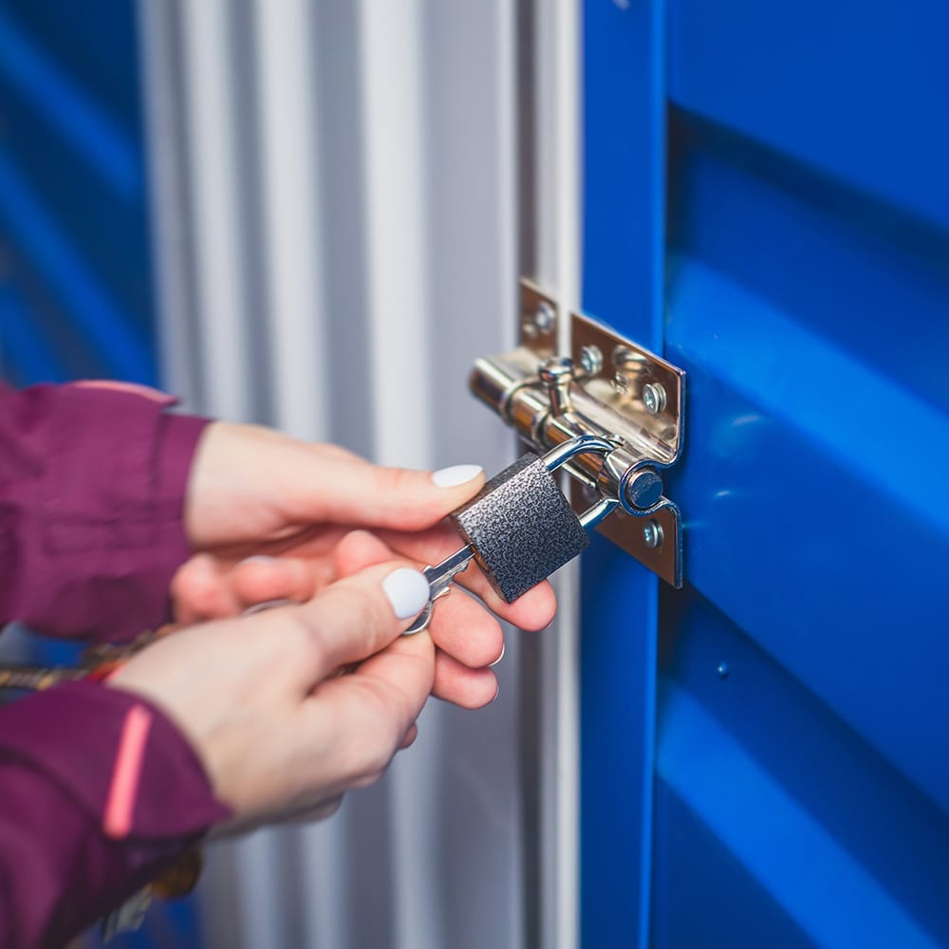
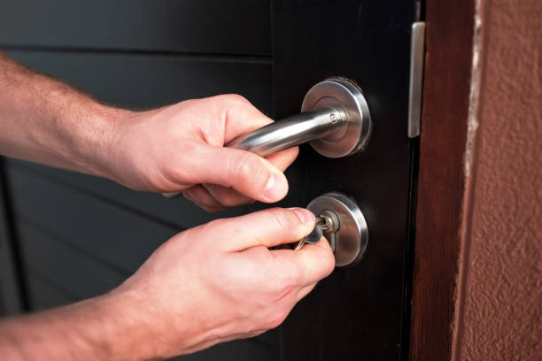
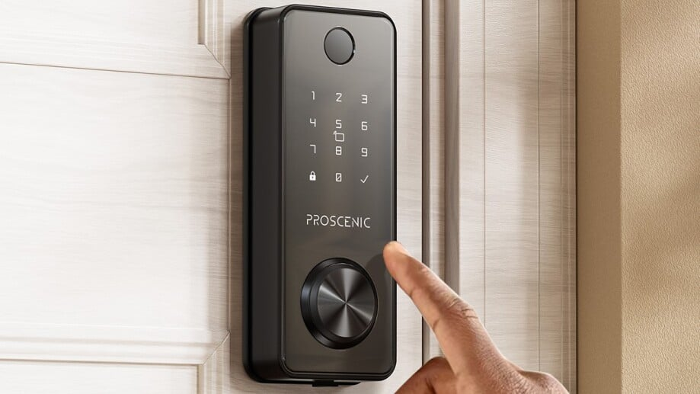
Existing system:
Most existing security systems use CCTV cameras with manual monitoring.
Some systems rely on motion detection, which often causes false alarms (e.g., animals, shadows, or normal movements).
Basic face recognition systems only display the detected face but do not provide alerts or notifications.
These systems:
Cannot give real-time warning to the owner.
Do not integrate with voice commands or email alerts.
May not work effectively under different lighting or camera angles.

Slide 5
DISADVANTAGES :
Requires continuous manual monitoring by security personnel.
Motion-based systems trigger many false positives (e.g., pets, shadows, moving objects).
No real-time alerts to the owner when unauthorized access happens.
Lack of voice interaction or user-friendly feedback.
No automatic email or message notification in case of intruders.
Limited accuracy in low light or with different face angles.

Slide 6
SYSTEM REQUIREMENTS:
Hardware Requirements
Laptop/PC with inbuilt or external webcam
Minimum 4 GB RAM, i3 processor or above
Storage space for saving images and logs
Internet connection (for sending email alerts)
Software Requirements
Operating System: Windows / Linux
Programming Language: Python 3.
xLibraries: OpenCV, NumPy, Pyttsx3, smtplib
Pre-trained models: Haar Cascade, LBPH Face Recognizer

Slide 7
PROPOSED SYSTEM:
Proposed SystemThe proposed system uses Face Recognition to enhance security.
It works in real-time to detect and recognize individuals.
If the face is recognized:
System greets with a voice message – “Welcome back [Name]”.
If the face is unknown:
System gives a voice alert – “Alert! Unknown person detected”.
Captures and saves the image of the intruder.
Sends an email notification with the snapshot to the owner.

Slide 8
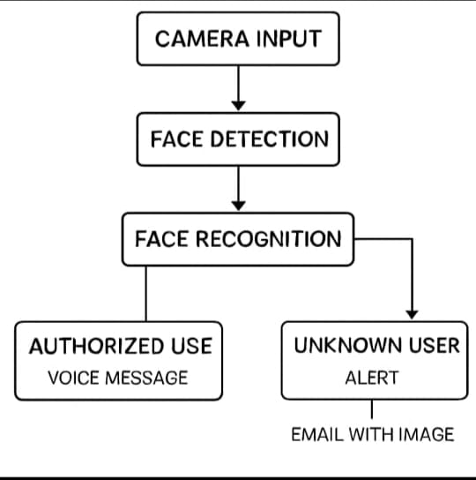
BLOCK DIAGRAM

Slide 9
ADVANTAGES OF PROPOSED SYSTEM
detection of authorized and unauthorized persons.
Provides voice feedback for both known and unknown users.
Instant email alert with intruder’s image improves security.
Reduces dependency on manual monitoring of CCTV.
More accurate than motion-based detection systems.Cost-effective and easy to implement using Python and OpenCV.
Can be extended with features like age, gender, and emotion detection.

Slide 10
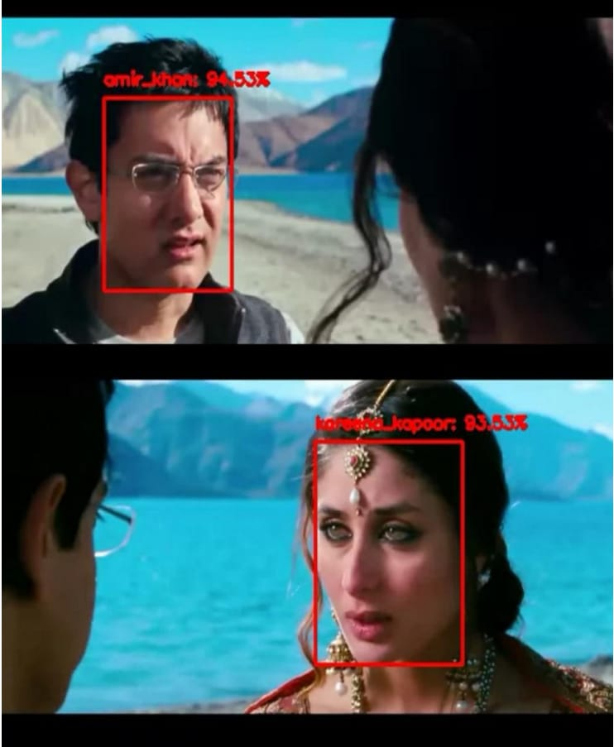
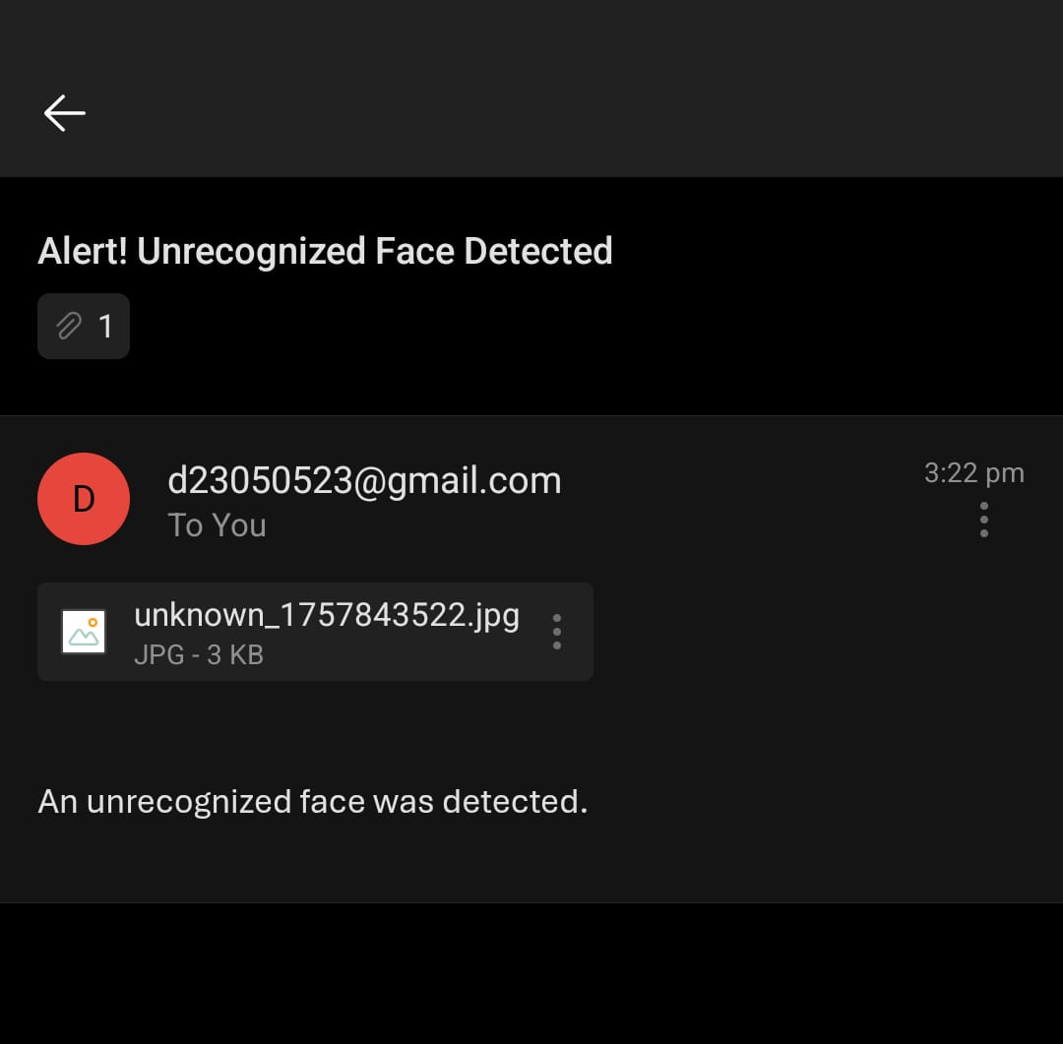
RESULT

Slide 11
CONCLUSION:
A Face Recognition Security System was successfully developed using Python and OpenCV.
The system greets known users with a personalized voice message.
For unknown persons, it raises a voice alert, captures the image, and sends an email notification to the owner.
This makes the system more interactive, reliable, and secure compared to traditional CCTV monitoring.

Slide 12
FUTURE SCOPE
Add Age & Gender Prediction to make recognition more informative.
Integrate Emotion Detection (happy, sad, angry, neutral).
Deploy on IoT devices like Raspberry Pi for smart home security.
Connect with smart door locks for access control.
Store logs in the cloud for remote monitoring.

Slide 13
REFERENCES
OpenCV Documentation – https://opencv.
orgPython pyttsx3 Documentation – https://pyttsx3.readthedocs.io
Python smtplib (Email) Documentation – https://docs.python.org/3/library/smtplib.html
Haar Cascade Classifier – https://docs.opencv.org/3.4/db/d28/tutorial_cascade_classifier.html
LBPH Face Recognizer - https://docs.opencv.org/3.4/dc/dc3/tutorial_py_face_detection.html

Slide 14


